Slide 1
NFPA 241 – Standard for Safeguarding Construction, Alterations and Demolition Operatons
Oct. 17, 2017 | Allan B. Fraser, CBI, CPCA Sr. Bldg Code Spec., NFPA

Slide 2
Quick Question:
When did NFPA begin to develop the standard NFPA 241, Safeguarding Construction, Alteration, and Demolition Operations?
The year was 1930.

Slide 3
Notes:
Waltham MA July 23, 2017 Apartments $110 million
Colorado August, 2017 Restaurant&Business No estimate
Weymouth August Condos $20-30 million
Dorchester June 2017 Apartments $45 million
Overland Park, KS March 2017 Apartments No Estimate
Edgewater, NJ Jan, 2015 Apartments No Estimate

Slide 4
Overview
Notes:
George Santayana (/ˌsæntiˈænə/ or /-ˈɑːnə/;^{[1]} December 16, 1863 – September 26, 1952), was a philosopher, essayist, poet, and novelist. Originally from Spain, Santayana was raised and educated in the United States from the age of eight and identified himself as an American, although he always kept a valid Spanish passport.^{[2]} He wr
Santayana is popularly known for aphorisms, such as "Those who cannot remember the past are condemned to repeat it",^{[3]} "Only the dead have seen the end of war",^{[4]}ote in English and is generally considered an American man of letters.

Slide 5
Feb. 2017 AvalonBay complex in Edgewater, NJ. two-thirds of the 235-unit complex

Slide 6
March 17, 2017 Raleigh, NC, 241-unit apartment building downtown

Slide 7
March 21, 2017 Overland Park, KS, apartment tower and to 22 nearby houses

Slide 8
July 7, 2017 Oakland, CA - 196 apartments and 31,500 square feet of retail space.

Slide 9
July 23, 2017 Waltham, MA, 264 apartments - $110 million

Slide 10
July 26, 2017 Dorchester, MA 83 apartments - $45 million

Slide 11
September 14, 2017 Weymouth, MA 50 condos - $30 million

Slide 12
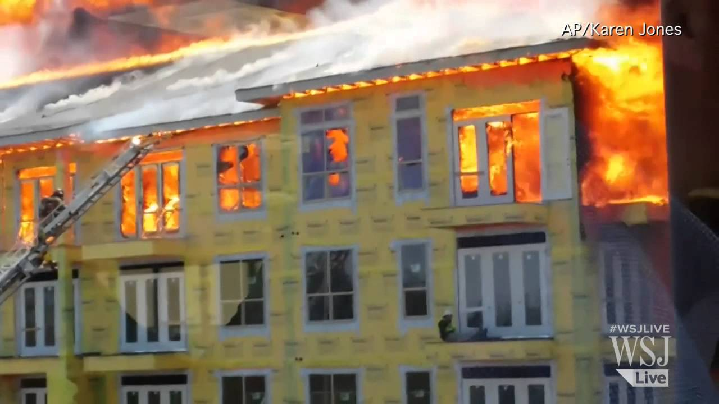
“Back to the Future”
Notes:
Society has had fires in buildings since we first started building them. Buildings in the course of construction have many additional fire hazards not found in completed structures. Fire protection equipment to restrict the spread of fire and extinguish it promptly has not yet been installed. Fires are often difficult of access by the fire department. Every opportunity exists for serious fire loss, as is amply evidenced by the partial fire record incorporated in this report.

